Slide 1

MALLA REDDY COLLEGE OF ENGINEERING FOR WOMEN
(Approved by AICTE New Delhi and Affiliated to JNTUH)
(B.Tech Programs-CSE & ECE Accredited by NBA)
(An ISO 9001 : 2015 Certified Institution)
Maisammguda, Medchal (M), Hyderabad-500100,Telangana
“5G SMART DIABETES TOWARDS PERSONALIZED DIABETES DIAGNOSIS WITH HEALTH CARE BIG DATA CLOUDS”
Submitted by
P.POOJA 21RG1A0540
S.ARCHANA 21RG1A0550
S.KAVYACHANDRIKA 21RG1A0552
T.AKHILA 22RG5A0506
Under the Guidance of
E.AVYAKTHA
M.TECH,ASSISTANT PROFESSOR

Slide 2
ABSTRACT
Recent advances in wireless networking and big data technologies, such as 5G networks, medical big data analytics, and the Internet of Things, along with recent developments in wearable computing and artificial intelligence, are enabling
the development and implementation of innovative diabetes monitoring systems and applications.
Due to the life-long and systematic harm suffered by diabetes patients, it is critical to design effective methods for the diagnosis and treatment of diabetes.
Based on our comprehensive investigation, this article classifies those methods into Diabetes 1.0 and Diabetes 2.0
which exhibit deficiencies in terms of networking and intelligence. Thus, our goal is to design a sustainable
cost-effective, and intelligent diabetes diagnosis solution with personalized treatment.
Notes:
5233074260

Slide 3
INTRODUCTION
CONCEPT
Diabetes is an extremely common chronic disease from which nearly 8.5 percent of the world population suffer; 422 million people worldwide have to struggle with diabetes.
It is crucial to note that type 2 diabetes mellitus makes up about 90 percent of the cases
More critically, the situation will be worse, as reported in with more teenagers and youth becoming susceptible to diabetes as well.
Due to the fact that diabetes has a huge impact on global well being and economy, it is urgent to improve methods for the prevention and treatment of diabetes.
PROBLEM SOLUTION
To solve the above problems, in this article, we first propose a next generation diabetes solution called the 5G-Smart Diabetes system
which integrates novel technologies including fifth generation (5G) mobile networks, machine learning, medical big data, social networking, smart clothing , and so on.

Slide 4
INTRODUCTION
OBJECTIVE OF PROJECT :
This project focuses on predicting the diabetes of the person by applying various machine learning techniques.
we first propose the 5G-Smart Diabetes system, which combines the state-of-the-art technologies such as wearable 2.0, machine learning, and big data to generate comprehensive sensing and analysis for patients suffering from diabetes.
Then we present the data sharing mechanism and personalized data analysis model for 5G-Smart Diabetes.
Finally, we build a 5G-Smart Diabetes testbed that includes smart clothing, smartphone, and big data clouds.
the experimental results show that our system can effectively provide personalized diagnosis and treatment suggestions to patients.

Slide 5
SYSTEM ANALYSIS
EXISTING SYSTEM:
As there is no staff available in unmanned restaurants, it is difficult for the restaurant management to estimate how the concept and the food is experienced by the customers. Existing
The rating systems, such as Google and Trip Advisor, only partially solve this problem, as they only cover a part of the customer’s opinions.
These rating systems are only used by a subset of the customers who rate the restaurant on independent rating platforms on their own initiative.
This applies mainly to customers who experience their visit as very positive or negative.
Notes:
The

Slide 6
SYSTEM ANALYSIS
PROPOSED SYSTEM:
In order to solve the above problem, all customers must be motivated to give a rating. This paper
introduces an approach for a restaurant rating system that asks every customer for a rating after their visit to increase the number of ratings as much as possible.
This system can be used unmanned restaurants; the scoring system is based on facial expression detection using pretrained convolutional neural network (CNN) models

Slide 7
SYSTEM ANALYSIS
ADVANTAGES OF PROPOSED SYSTEM:
Smartness
With cognitive intelligence toward patients' status
network resources
5G-Smart Diabetes achieves early detection and prevention of diabetes and provides personalized treatment to patients.

Slide 8
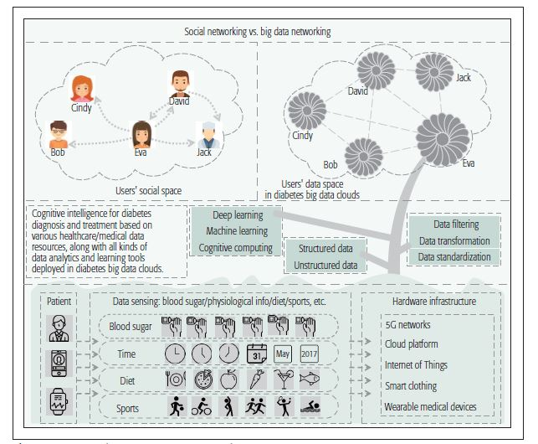
SYSTEM ARCHITECTURE

Slide 9
MODULES:
Upload 5G smart Diabetes:
we present the data sharing mechanism and personalized data analysis model for 5G-Smart Diabetes
Preprocess Dataset
Experiments were conducted on Indian government dataset and gives the highest yield prediction accuracy
Train Machine Learning
This focuses on district wise yield prediction according to the crop sown in the district. Yield is being predicted for given crops district wise and crops with best yield.
Upload Test Data &Predict Yield
Results reveals that Random Forest is the best classifier when all parameters are combined.
.

Slide 10
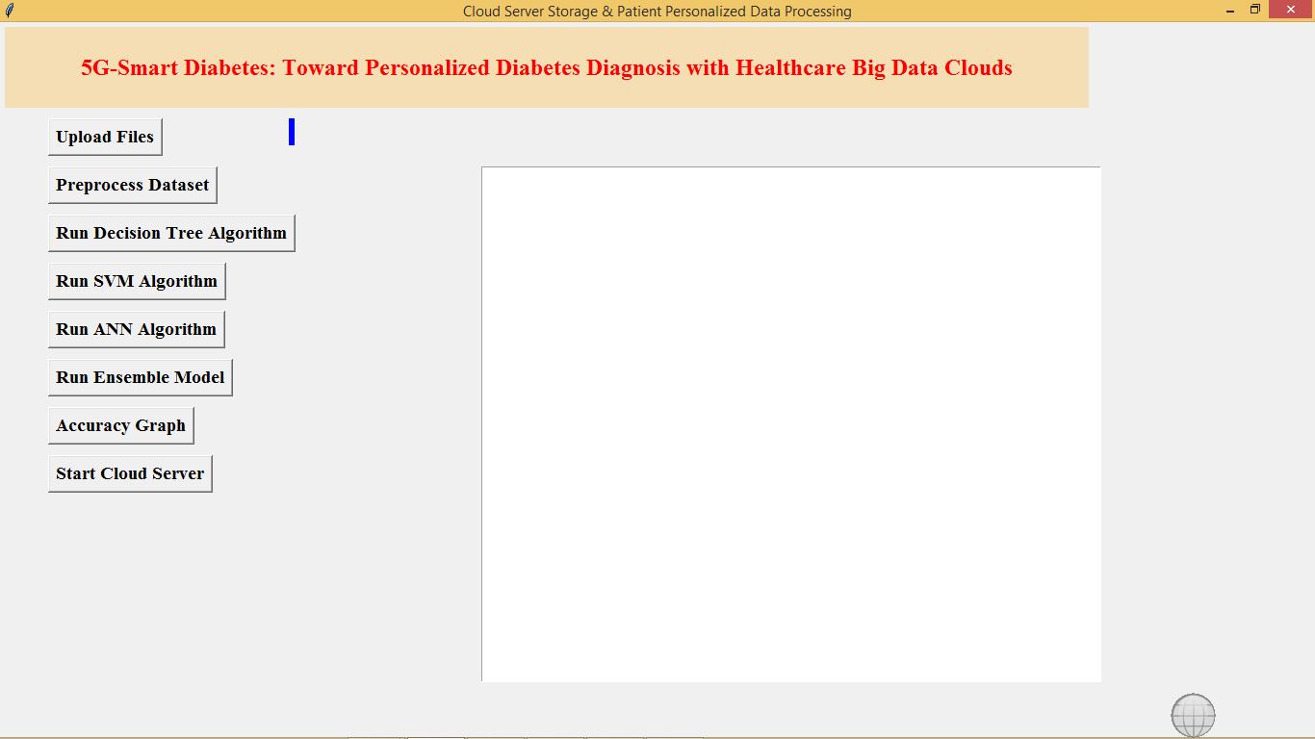
RESULT
Fg-1: In above screen click on ‘Upload Files’ button to upload diabetes dataset

Slide 11
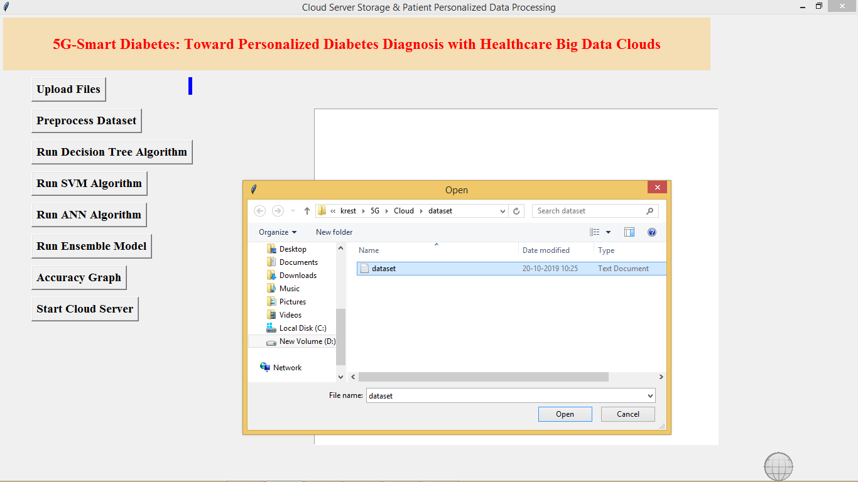
Fg-2 After uploading dataset click on ‘Pre-process Dataset’ button to clean dataset

Slide 12
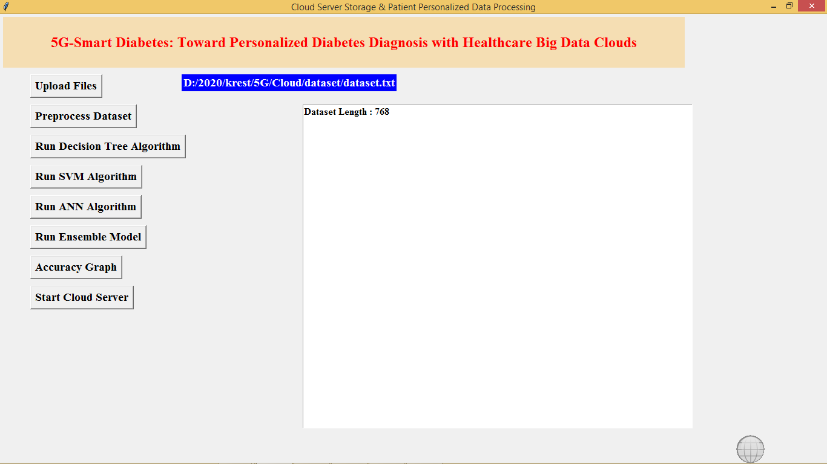
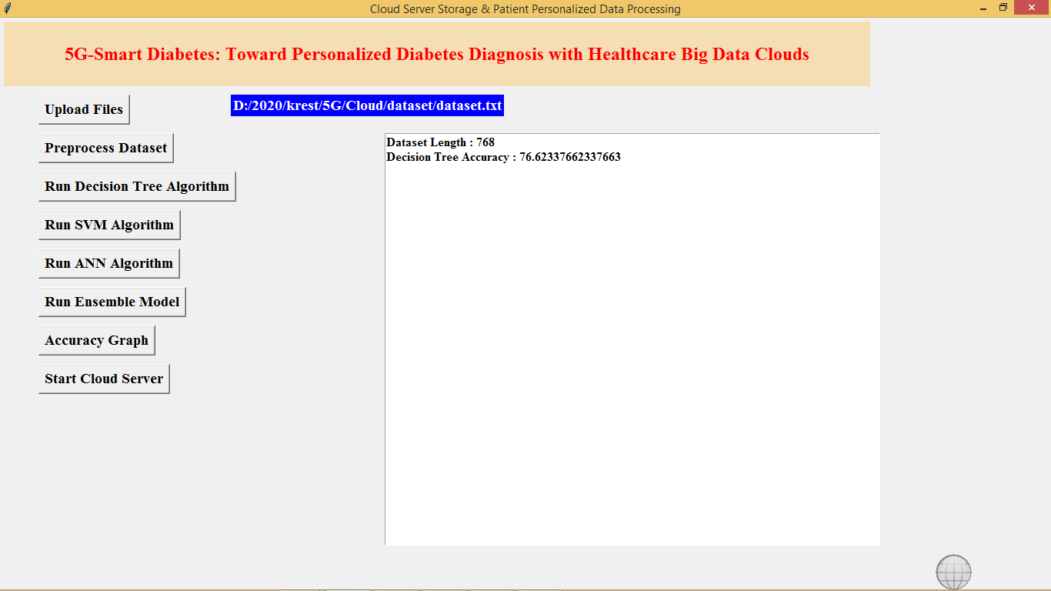
Fg-3: In above screen after pre-process total dataset records are 768. Now click on ‘Run Decision Tree Algorithm’ to build decision tree model and below is its accuracy
Fg-4: Similarly run other buttons to build models with algorithms

Slide 13
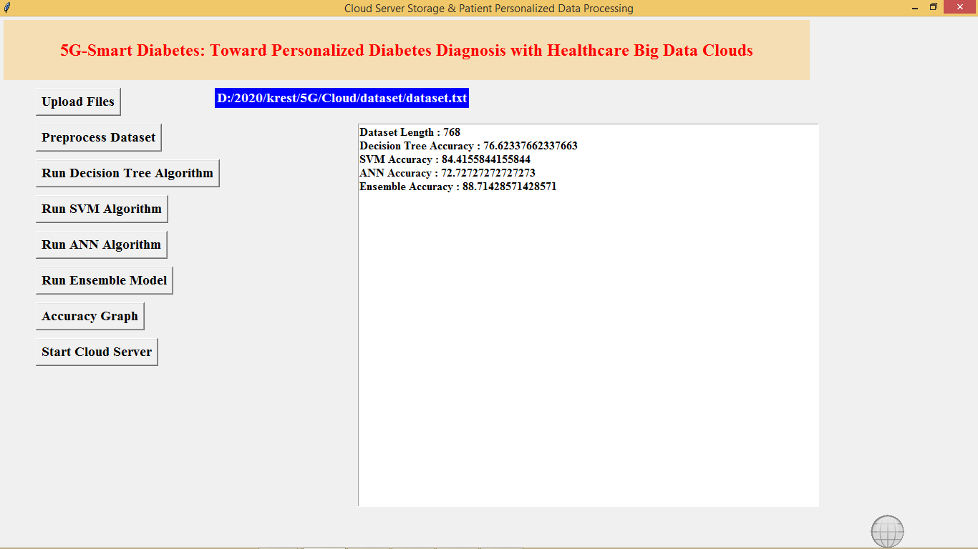
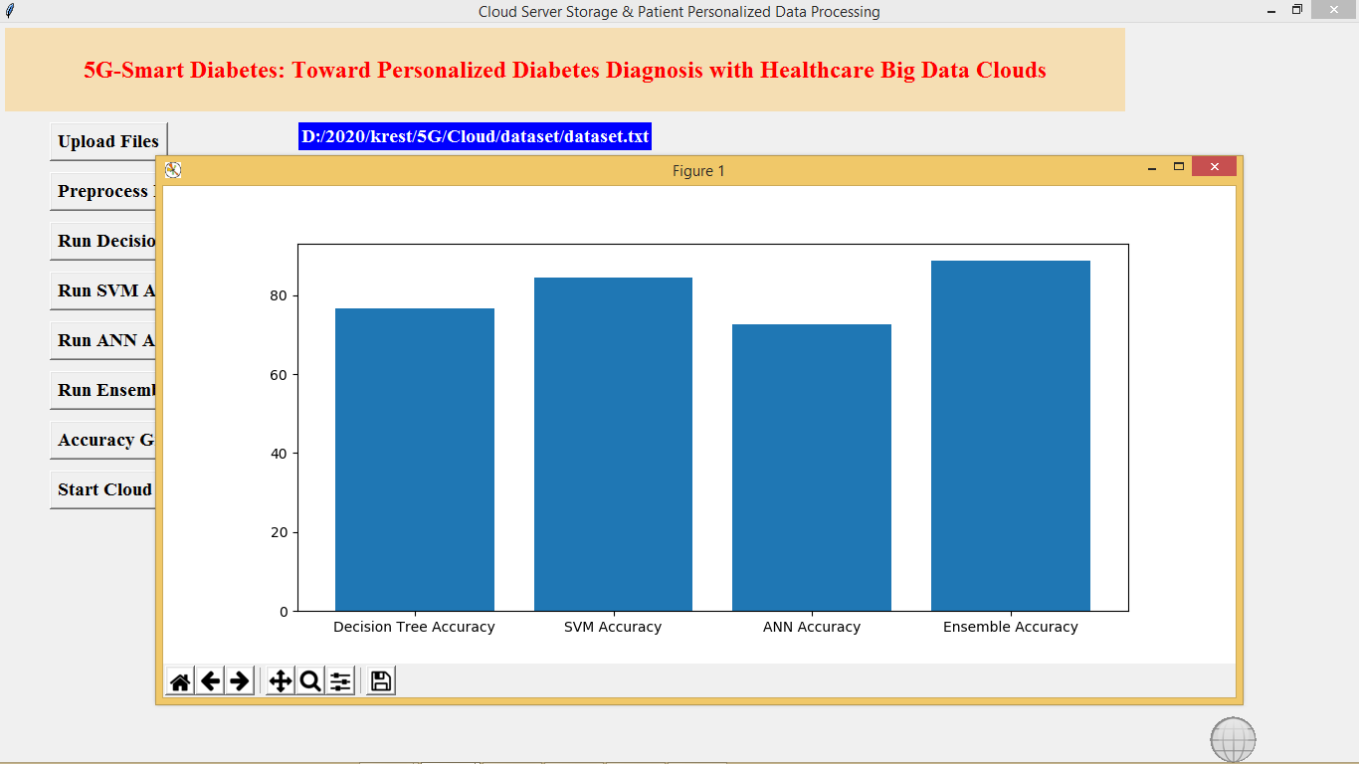
Fg-5: In above screen we got accuracy for all algorithms, now click on ‘Accuracy Graph’ button to get accuracy of all algorithms
Fg-6:In above screen graph x-axis represents algorithm name and y-axis represents accuracy values.
Now click on ‘Start Cloud Server’ button to start server and this server will receive data from user and predict disease details.

Slide 14
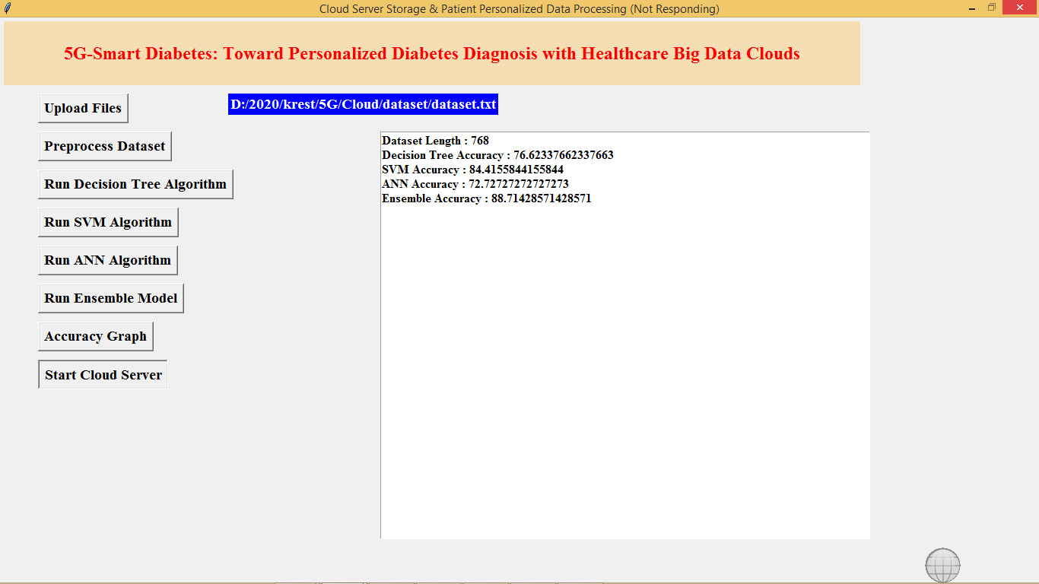
Fg-7 : In above screen cloud server started and now double clicks on ‘run.bat’ file from User folder to start User sensing application and to get below screen

Slide 15
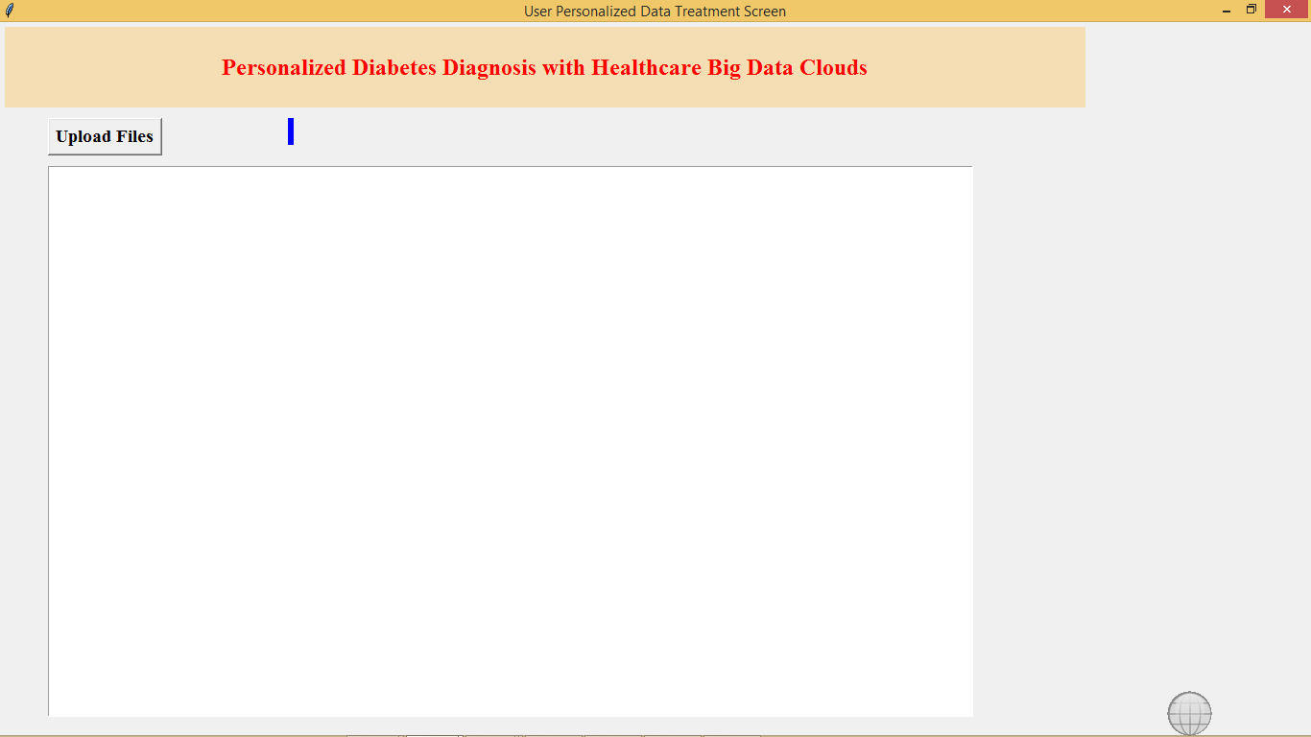
Fg-8: In above screen click on ‘Upload Files’ button to upload test file and to predict patient condition

Slide 16
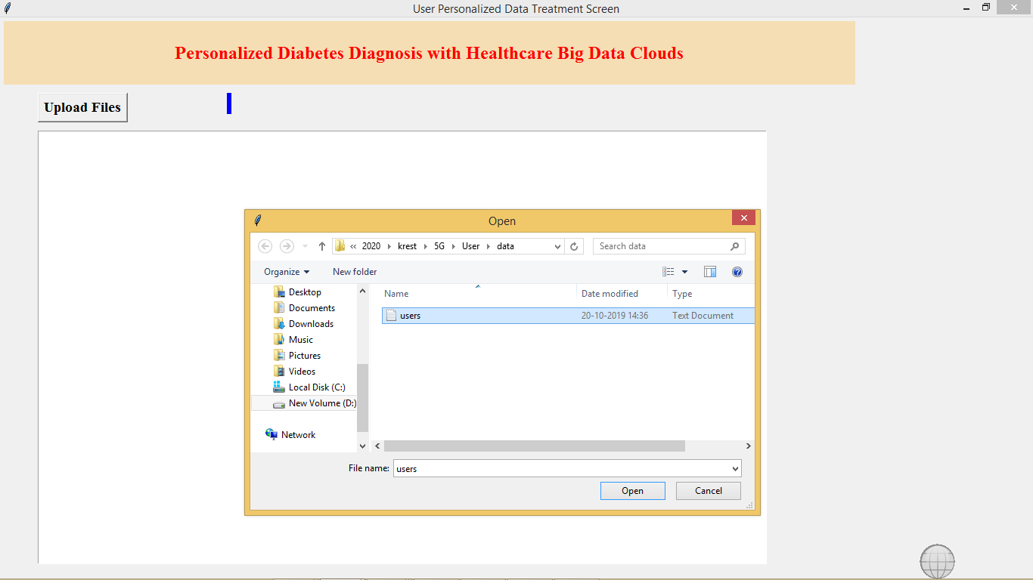
Fg-9: After uploading users data will get below prediction results

Slide 17
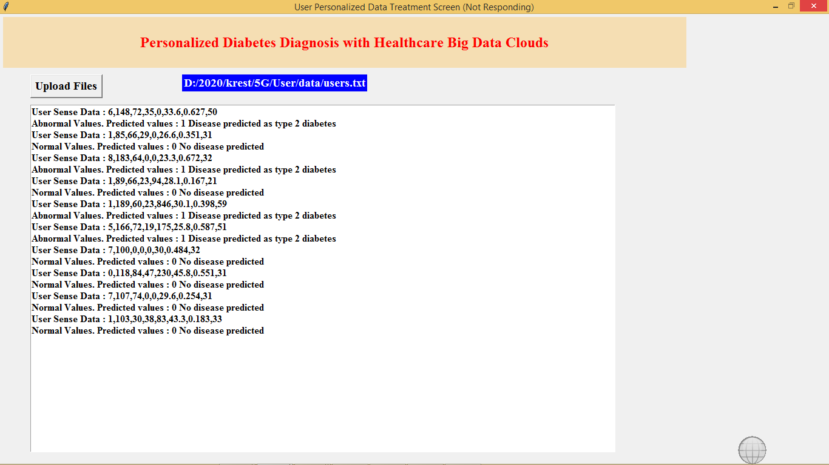
Fig 10: In above screen for each users data we predicted 0 and 1 values and also indicates patient values as normal or abnormal
All algorithms code you can see inside Cloud/Cloud.py file, in below screen we can all algorithms from python

Slide 18
CONCLUSION
In this article, we first propose a 5G-Smart Diabetes system that includes a sensing layer, a personalized diagnosis layer, and a data sharing layer.
Compared to Diabetes 1.0 and Diabetes 2.0, this system can achieve sustainable, cost-effective, and intelligence diabetes diagnosis.
Then we propose a highly cost-efficient data sharing mechanism in social space and data space.
In addition, using machine learning methods, we present a personalized data analysis model for 5G-Smart Diabetes.
Finally, based on the smart clothing, smartphone and data center, we build a 5G-Smart Diabetes tested.
The experimental results show that our system can provide personalized diagnosis and treatment suggestions to patients.

Slide 19


